Slide 1

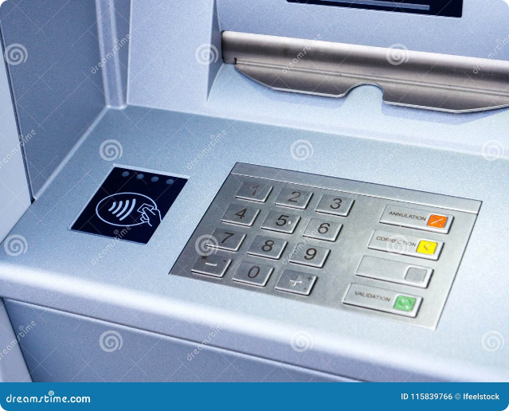
ATM Machine: Your Secure Banking Companion
Discover the convenience and security of our state-of-the-art ATM machine, designed to simplify your banking experience. Manage your finances with ease, from checking balances to making deposits and withdrawals.
by Rana Sujeet Kumar

Slide 2

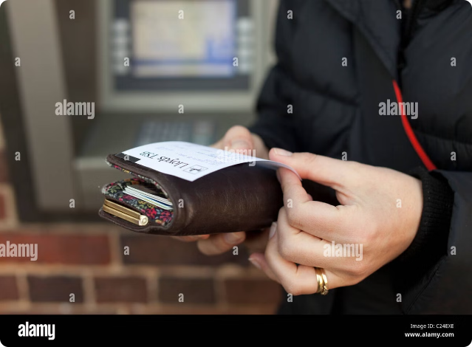
Checking Your Balance
1
Quick Balance Check
Instantly view your current account balance.
2
Transaction History
Review your recent transactions for transparency.
3
Secure and Reliable
Our ATM ensures the safety of your financial information.

Slide 3
Withdrawing and Depositing Cash
Withdrawals
Deposits
Convenient
Easily withdraw the exact amount you need, with no minimum or maximum limits.
Securely deposit cash and checks, ensuring your funds are available immediately.
Manage your money on your schedule, 24/7, with our user-friendly ATM.

Slide 4

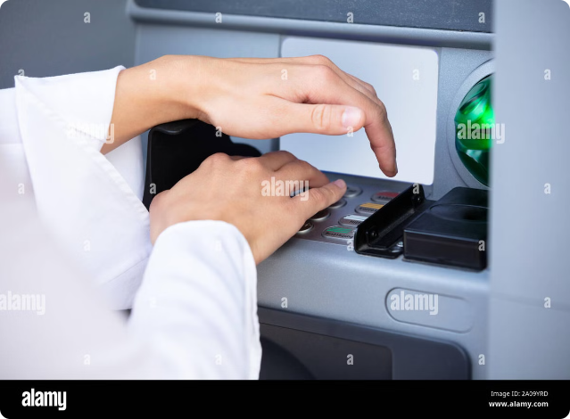
Changing Your PIN
Secure Your Account
Regularly update your PIN to protect your financial information.
Easy Process
Our ATM guides you through the simple steps to change your PIN.
Personalized Security
Choose a PIN that is memorable to you, yet difficult for others to guess.

Slide 5
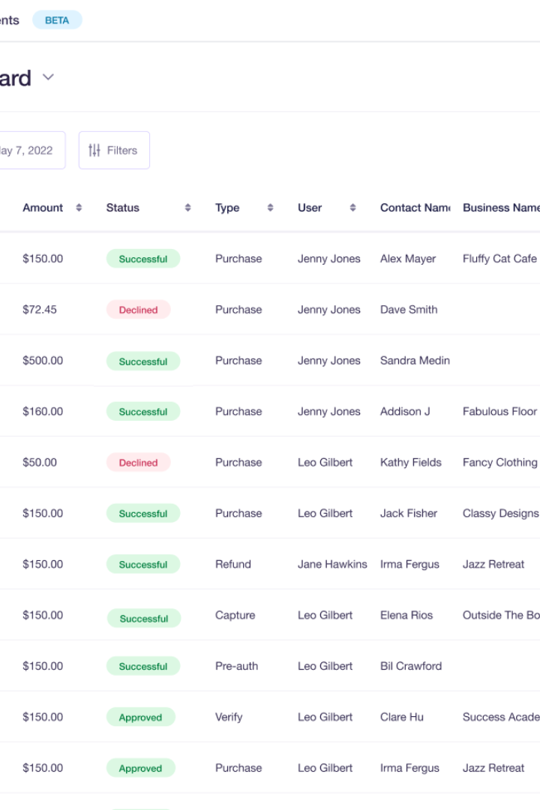
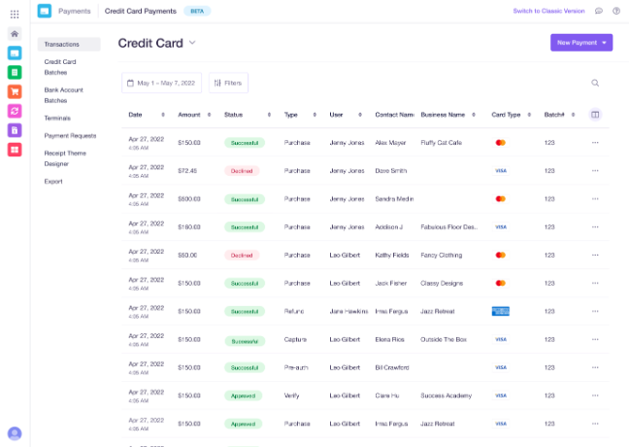
Reviewing Transaction History
1
Deposits
Track all your cash and check deposits for financial transparency.
2
Withdrawals
Monitor your withdrawal activity to ensure accurate record-keeping.
3
PIN Changes
Stay informed about any updates to your personal identification number.

Slide 6

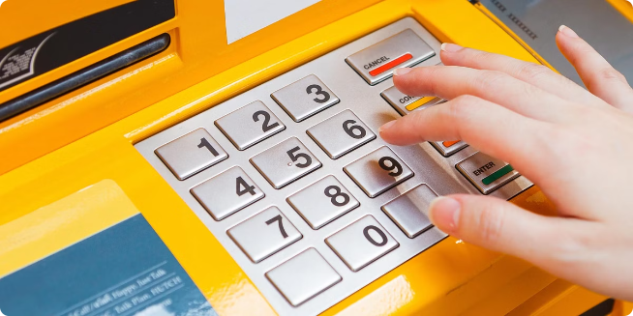



Secure and Reliable Banking
Encrypted
Your data is protected with advanced encryption technology.
Tamper-Resistant
Our ATM is designed to deter and detect any unauthorized access.
24/7 Availability
Manage your finances anytime, day or night, with our reliable ATM.

Slide 7



Java: Class, Object, and Method Flowchart
Class Definition
Establish the blueprint for an object, including its properties and behaviors like balance, pin, and transaction history.
Object Creation
Instantiate an ATM object from the class, giving it unique initial balance and PIN values.
Method Invocation
Call methods on the ATM object to perform various actions like checking balance, withdrawing, depositing, changing PIN, and printing transaction history.

Slide 8






ATM System Design Flowchart
User Interface
The ATM provides a user-friendly interface for customers to access their banking services.
ATM Controller
The ATM Controller manages the core functionality, processing user inputs and communicating with the display and data store.
ATM Display
The ATM Display presents information to the user, such as account balances, transaction history, and prompts for user input.
ATM Class
The ATM Class encapsulates the properties and behaviors of the ATM, serving as the central component of the system.
Transaction Operations
The Transaction Operations module handles all the financial transactions, including deposits, withdrawals, and balance inquiries.
Data Store
The Data Store securely maintains the user's account information, transaction history, and other sensitive data.

Slide 9



The ATM Class: Powering Secure Banking Transactions
Properties
1
Balance, PIN, Transaction History
2
Constructor
Initialize Account with Balance and PIN
Methods
3
Check Balance, Withdraw, Deposit, Change PIN, Print History
The ATM class serves as the backbone of our secure banking system, encapsulating the essential attributes and functionalities required for seamless financial transactions. At the core of this class are the key properties that define an ATM account: the account balance, personal identification number (PIN), and a comprehensive transaction history. The constructor initializes these vital elements, setting the stage for the powerful set of methods that empower users to manage their finances with ease and confidence.

